Slide 1

11
The Project Team

Slide 2
Chapter Concepts
How teams are acquired and assigned
The development and growth of teams
The project kickoff meeting
Characteristics of effective project teams and barriers to effectiveness
Being an effective team member
Team building
Valuing team diversity
Ethical behavior
Sources of conflict during the project and approaches to handling conflict
Problem solving and brainstorming
Effective time management

Slide 3
Learning Outcomes
Explain how teams are assigned and formed
Identify and describe the stages of team development
Plan and conduct a project kickoff meeting
Discuss characteristics of effective teams
Identify and describe at least five barriers to team effectiveness
Be an effective team member
Take actions to support team building
Identify at least five dimensions of diversity, and discuss the value of team diversity
Behave ethically in a project environment
Identify at least four sources of conflict on projects, and explain how to handle conflict
Apply the problem solving process and the brainstorming technique
Manage time effectively

Slide 4
Project Resource Management
Project Management Knowledge Areas from PMBOK® Guide

Slide 5
Acquiring the Project Team
Project teams
  What expertise, experience, or skills needed
  How many of each type are required
  When they will be needed
    Acquire entire team for smaller projects
    Assemble team members as needed for larger projects
Greatest constraint is the availability of the right resources at the right time
May have to negotiate for resources
Keep team as small as feasible

Slide 6
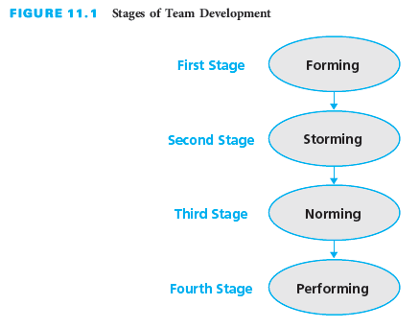
Project Team Development

Slide 7
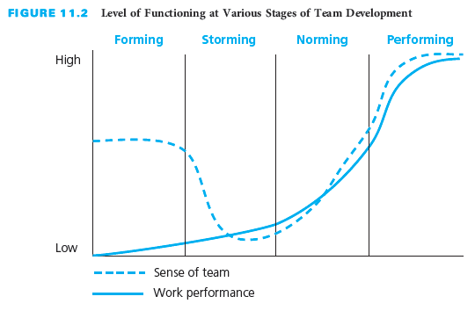
Forming
Initial stage
Individuals get acquainted
Positive expectations
Little work accomplished
Depend on direction and structure
Lots of questions
  What purpose?
  Who are others?
  What are they like?

Slide 8
Storming
Second stage
Start to apply their skills to work
Tasks may be larger than anticipated
Increasing dissatisfaction with dependence
Test the limits and flexibility of the team
  Conflict emerges and tension increases
  Motivation and morale are low
  Members express individuality

Slide 9
Norming
Third stage
Relationships have settled
Interpersonal conflicts resolved
Team has accepted its operating environment
Control and decision making are transferred to the project team
Cohesion begins to develop
Trust begins to develop
Team members give and ask for feedback
Feeling of camaraderie emerges

Slide 10
Performing
Fourth stage
High commitment to achieve project objective
High level of work performance
Communication is open
Collaboration and willingness to help each other
Team feels fully empowered
Project manager fully delegates responsibility and authority
Project manager is mentor

Slide 11
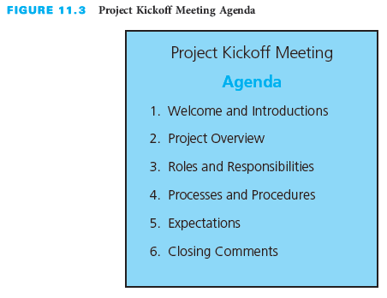
Project Kickoff Meeting
Project orientation
Held as early as possible
Sets the tone for the project
Provides opportunity for team to know each other
Clarify roles and responsibilities
Describe protocols and plans
Allow time for questions and comments

Slide 12
Effective Project Teams
More than a group of individuals
  Group of interdependent individuals
  Work cooperatively to achieve the project objective
Develop and grow into a cohesive, effective team
  Takes effort on the part of the project manager and each member

Slide 13
Characteristics of Effective Teams
Clear understanding of the project objective
Clear expectations of each person’s role and responsibilities
Results orientation
High degree of cooperation and collaboration
High level of trust

Slide 14
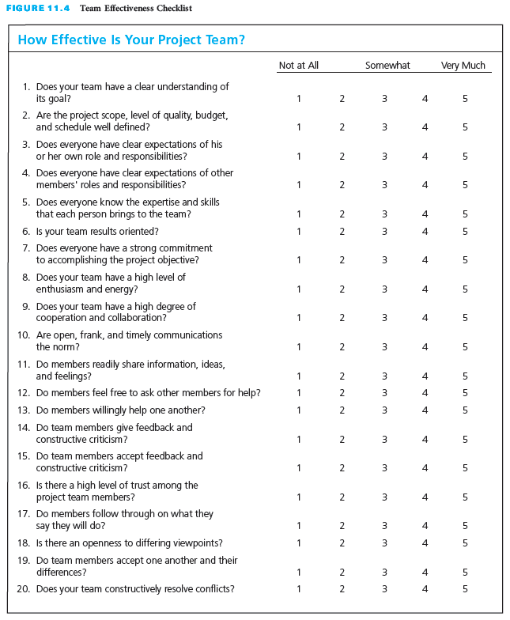
Rate Team Effectiveness

Slide 15
Team Building
An ongoing process
The responsibility of both the project manager and the project team
Socialization supports team building
Enhanced by members getting to know one another
  Discussions not all work related
  Initiate social events to celebrate achievements
Have team meetings, not just project meetings

Slide 16
Valuing Team Diversity
Acknowledge, understand, and value differences
  Create a work environment that recognizes, respects, and harnesses differences
  Accomplish a shared goal
Differences can create barriers to team performance
  May lead to miscommunication and misunderstanding
  Can result in low morale, diminished trust, reduced productivity, greater tension, and suspicion
  Can become a serious impediment, if not managed properly
Under good management, diversity can lead to more creative, faster results, and higher-quality problem solving and decision making

Slide 17
Valuing Team Diversity Actions
Should NOT Do
Should Do
Stereotype or make assumptions
Exclude or have lower expectations
Draw attention to diversity
Make derogatory or insensitive remarks because it demeans the dignity of others
Tell jokes, ridicule, or make fun
Create and sustain a supportive and positive climate
Develop a written diversity policy
Provide diversity training
Raise awareness and create understanding
Help diminish misunderstanding and conflict
Make a personal commitment to understand, value, and respect diversity

Slide 18
Ethical Behavior
Opportunities for unethical behavior
  Some circumstances are debatable regarding misbehavior
  Project manager’s responsibility to set the tone and expectations
Actions to prevent wrongdoing
  Have a policy on ethical behavior
  Conduct training sessions on ethical behavior
Non-threatening process to report any actions
Members must feel accountable

Slide 19
Key Principles to Guide Ethical Behavior
Treat others the way you want to be treated
Don’t do anything you wouldn’t want your family, friends, neighbors, or co-workers to read about in the newspaper or hear on the news

Slide 20
Conflicts on Projects
Sources of Conflict
Handling Conflict Approaches
Work Scope
Resource Assignments
Schedule
Cost
Priorities
Organizational issues
Stakeholder issues
Personal differences
Avoiding or Withdrawing
Competing or Forcing
Accommodating or Smoothing
Compromising
Collaborating, Confronting, or Problem Solving

Slide 21
Problem Solving
Nine-Step Approach
  Develop a problem statement
  Identify potential causes of the problem
  Gather data and verify the most likely causes
  Identify possible solutions
  Evaluate the alternative solutions
  Determine the best solution
  Revise the project plan
  Implement the solution
  Determine whether the problem has been solved

Slide 22
Brainstorming
All members of a group contribute spontaneous ideas in a non-judgmental environment
Explore as broad a range of options and ideas
The process
  The team sits around a table, with a facilitator who records ideas
  Member states an idea – do not discuss, justify, or try to sell it
  Build on ideas previously mentioned
  Continue until no one can come up with any more ideas or the time limit is up
Two important rules must be followed
  No immediate discussion of ideas
  No judgmental comments
Other participants are not allowed to make any comments at all, supportive or judgmental

Slide 23
Time Management
Identify goals to accomplish the following week
At the end of each day, make a to-do list for the next day
Read to-do list first thing in the morning, and keep it in sight all day
Control interruptions from the items on your to-do list
Learn to say no to activities that will consume time but not contribute to accomplishing goals
Make effective use of waiting time
Try to handle most paperwork only once
Go through incoming e-mail or mail at the end of the day so that it will not divert from working on day’s to-do list
Take action on each mail document while holding it
Reward at end of week if accomplished all week’s goals

Slide 24
Critical Success Factors
Project success requires an effective project team. Although plans and project management techniques are necessary, it is the people—the project manager and project team—who are the key to project success.
Putting a group of people together to work on a project does not create a team. Helping these individuals develop and grow into a cohesive, effective team takes effort on the part of the project manager and each member of the project team.
Project teams should be kept as small as feasible throughout the project.
A project kickoff meeting should be held as early as possible to inform members, reduce anxiety, manage expectations, and inspire the team.
Characteristics of effective project teams include a clear understanding of the project objective, clear expectations of each person’s roles and responsibilities, a results orientation, a high degree of cooperation and collaboration, and a high level of trust.
Each member of the project team needs to help create and foster a positive project environment.

Slide 25
Critical Success Factors (continued)
Effective team members have high expectations of themselves. They plan, control, and feel accountable for their individual work efforts.
Members of effective teams have open, frank, and timely communication. They readily share information, ideas, and feelings. They provide constructive feedback to each other.
Effective team members go beyond just doing their assigned tasks; they act as a resource for each other.
Diversity of the team brings unique ideas and perspectives to projects.
Individual team members make a personal commitment to understand and value diversity and respect the differences of other team members.
Diversity is valued as a strength that will enrich communication, foster better relationships, create an enjoyable workplace, and enhance team performance.
Ethical behavior is crucial in project business relationships with the customer, suppliers, and subcontractors.

Slide 26
Critical Success Factors (continued)
The project manager and the project team need to acknowledge openly that disagreement is bound to occur during the performance of the project and reach consensus on how it should be handled.
Effective project teams resolve conflict through constructive and timely feedback and positive confrontation of the issues. Disagreement is not suppressed; it is viewed as normal and as an opportunity for growth.
Handled properly, conflict can be beneficial. It causes problems to surface and be addressed. It stimulates discussion and requires individuals to clarify their views. It can foster creativity and enhance problem solving.
Conflict is not just for the project manager to handle and resolve; conflict between team members should be handled by the individuals involved.
Each person must approach the conflict with a constructive attitude and a willingness to work in good faith with others to resolve the issues.
To effectively manage their time, team members should establish weekly goals and make daily to-do lists.

Slide 27
Summary
A team is a group of individuals working interdependently to accomplish the project objective.
Project teams evolve through various stages of development: forming, storming, norming, and performing.
The project manager should schedule a project kickoff meeting with the project team as early as possible during the forming stage of team development to inform the members, reduce anxiety, manage expectations, and inspire the team.
Effective project team characteristics include a clear understanding of the project objective, clear expectations of each person’s role and responsibilities, a results orientation, a high degree of cooperation and collaboration, and a high level of trust.
Barriers to team effectiveness include: unclear vision and objective, unclear definition of roles and responsibilities, lack of project structure, lack of commitment, poor communication, poor leadership, turnover of project team members, and dysfunctional behavior.

Slide 28
Summary (continued)
Team building is the responsibility of both the project manager and the project team.
Diversity is about acknowledging, understanding, and valuing differences, and creating a work environment that recognizes, respects, and harnesses differences among team members for the benefits of accomplishing a shared goal, such as the project objective.
Ethical behavior is necessary within a project organization and is crucial in project business relationships with the customer, suppliers, and subcontractors.
Dealt with properly, conflict can be beneficial because it causes problems to surface and be addressed.
A good nine-step problem-solving approach is to develop a problem statement, identify potential causes of the problem, gather data and verify the most likely causes, identify possible solutions, evaluate the alternative solutions, determine the best solution, revise the project plan, implement the solution, and determine whether the problem has been solved.
Good time management is essential for a high-performance project team.

